Slide 1


Network protocols & security
24EC2210
Topic:
Data Encryption Standard (DES)
Session – 37

Slide 2
Data Encryption Standard(DES) Block Cipher

Slide 3
Data Encryption Standard(DES)
Data Encryption Standard (DES) is the symmetric block cipher which encrypts a 64-bit plain text in a 64-bit ciphertext.
Introduced by the National Institute of Standard and Technology (NIST) in the 1970s.
Initially, DES was only used in financial applications but later it was accepted as the cryptographic algorithm by other organizations too.

Slide 4
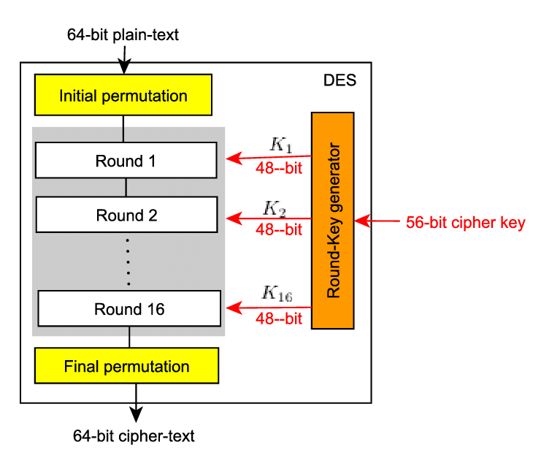
DES is a block cipher.
Encrypts blocks of 64-bits.
Uses a key of 56-bit.
Same key is used in encryption and decryption process of DES.
No. of Rounds: 16

Slide 5
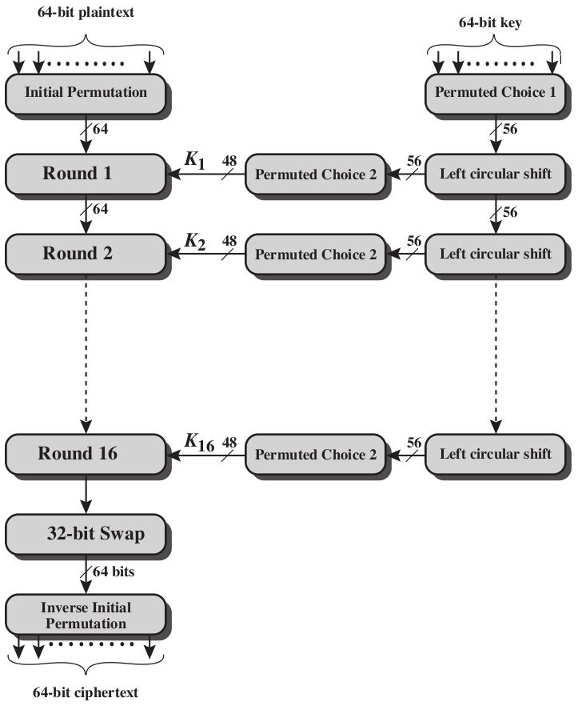

Slide 6
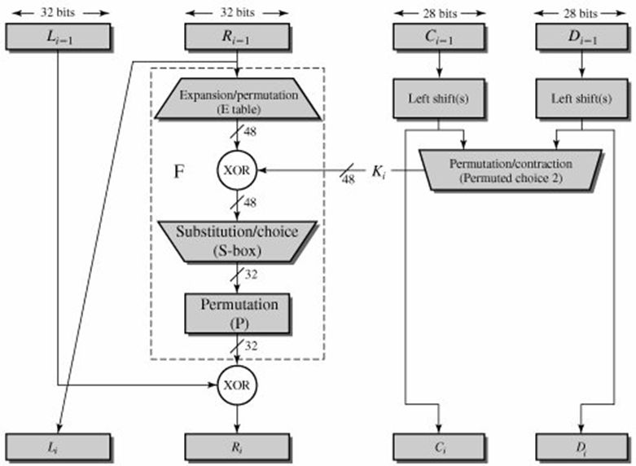

Slide 7
S-DES (Simplified DES)
Used for better understanding of DES.
Plaintext size: 8-bit
Key : 10-bit
No. of rounds: 2
Ciphertext : 8-bit

Slide 8
S-DES example
S-DES example

Slide 9
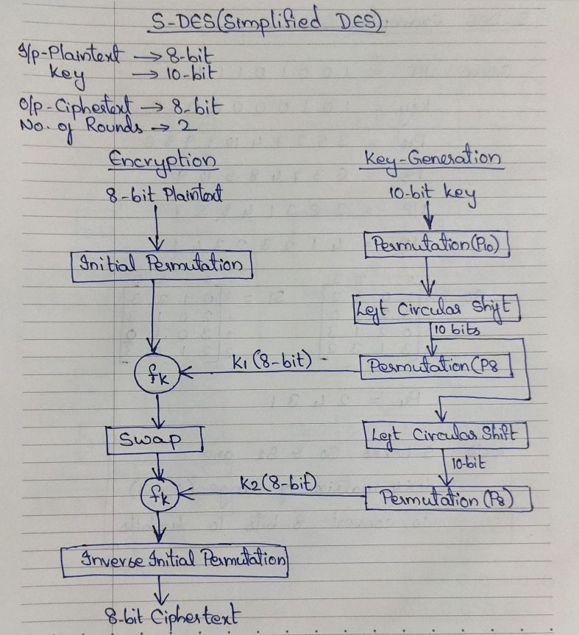

Slide 10
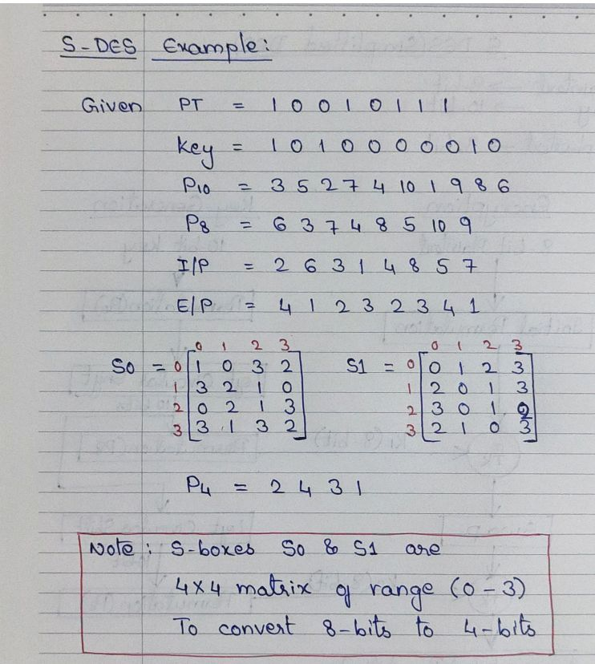

Slide 11
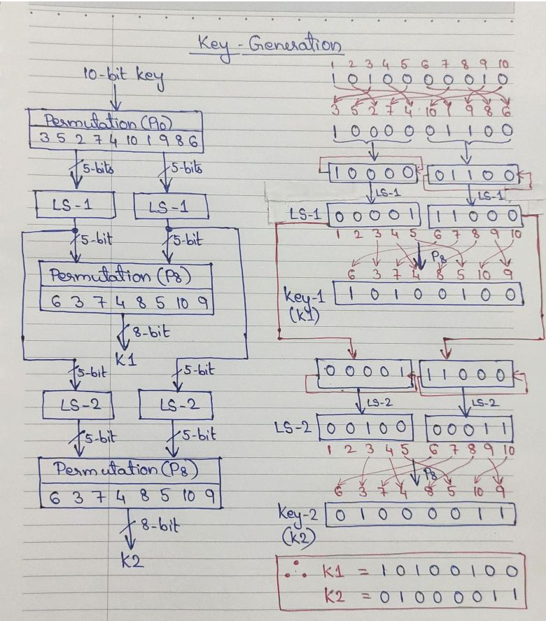

Slide 12
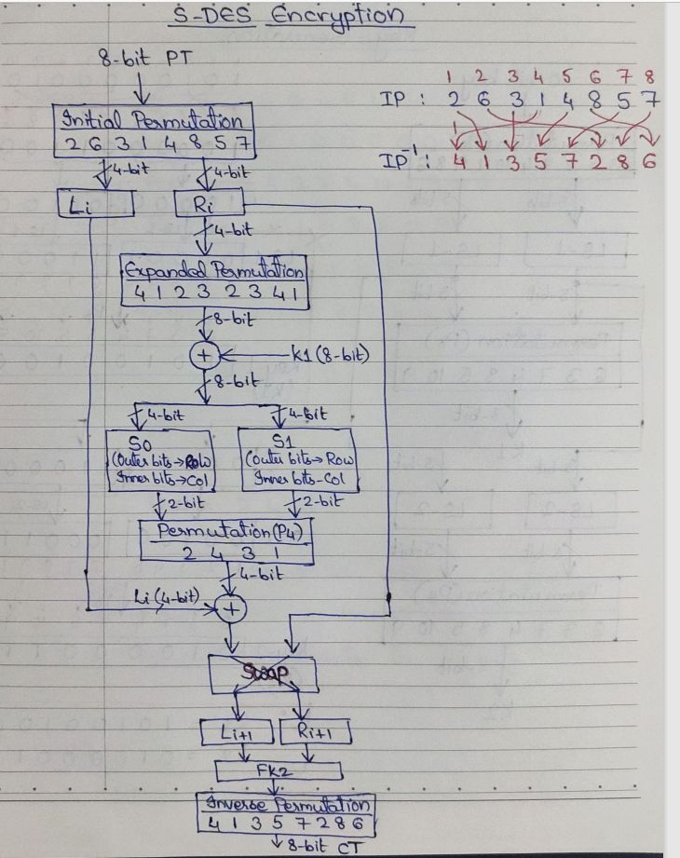

Slide 13
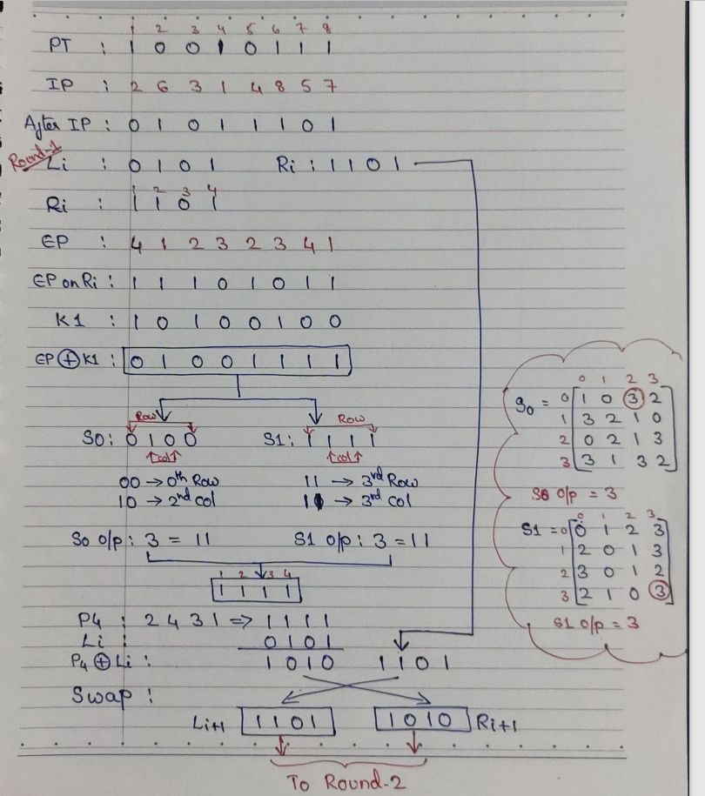

Slide 14
